Slide 1
TOWARDS A CONTINENTAL LAND DEGRADATION MONITORING SERVICE MISLAND-AFRICA
Mustapha MIMOUNI
Observatoire du Sahara et du Sahel (OSS)

Slide 2
Introduction/Background
What is MISLAND Africa ?
Set consisting of a platform to access the operational web service and a Qgis Open source plugin (for remote sensing experts), that provides timely information for policy makers, environmental agencies and natural resources managers using EO
Rely on international standards related to SDG 15.3.1 (proportion of degraded land to total land area) and technical approaches to provide regularly updated information on land cover gains/losses.
Integrated the North-Africa specificities and is targeting the continental coverage through a participatory approach (African institutions - AUC support)

Slide 3
Statement of the problem
Despite being red, Mars is a cold place full of iron oxide dust
How much forest area is lost due to forest fires?
Where are my land degradation hotspots?
Needs
Needs
Where are my vegetation loss/gain hotspots ?
Are we achieving land degradation neutrality ? Trends ?
Urban extension over agricultural lands?
How are my forest changing over time?
Risk ? Vulnerability?
Information ?

Slide 4
Objectives
Objectives of MISLAND
Main objective: To provide timely information on land degradation at a regular frequency using EO data. This will allow assessment of vulnerabilities, characterization of degradation severity and trends.
Specific Objectives:
Provide a harmonized set of land degradation indicators (including SDG 15.3.1).
Support environmental agencies in developing/adapting methodologies for monitoring and evaluating land degradation indicators.
Disseminate information, in a simplified and customizable way, for technical experts and decision making.
Guide policy (design/implementation) in North Africa and support monitoring of the SDGs (especially 15.3.1).

Slide 5
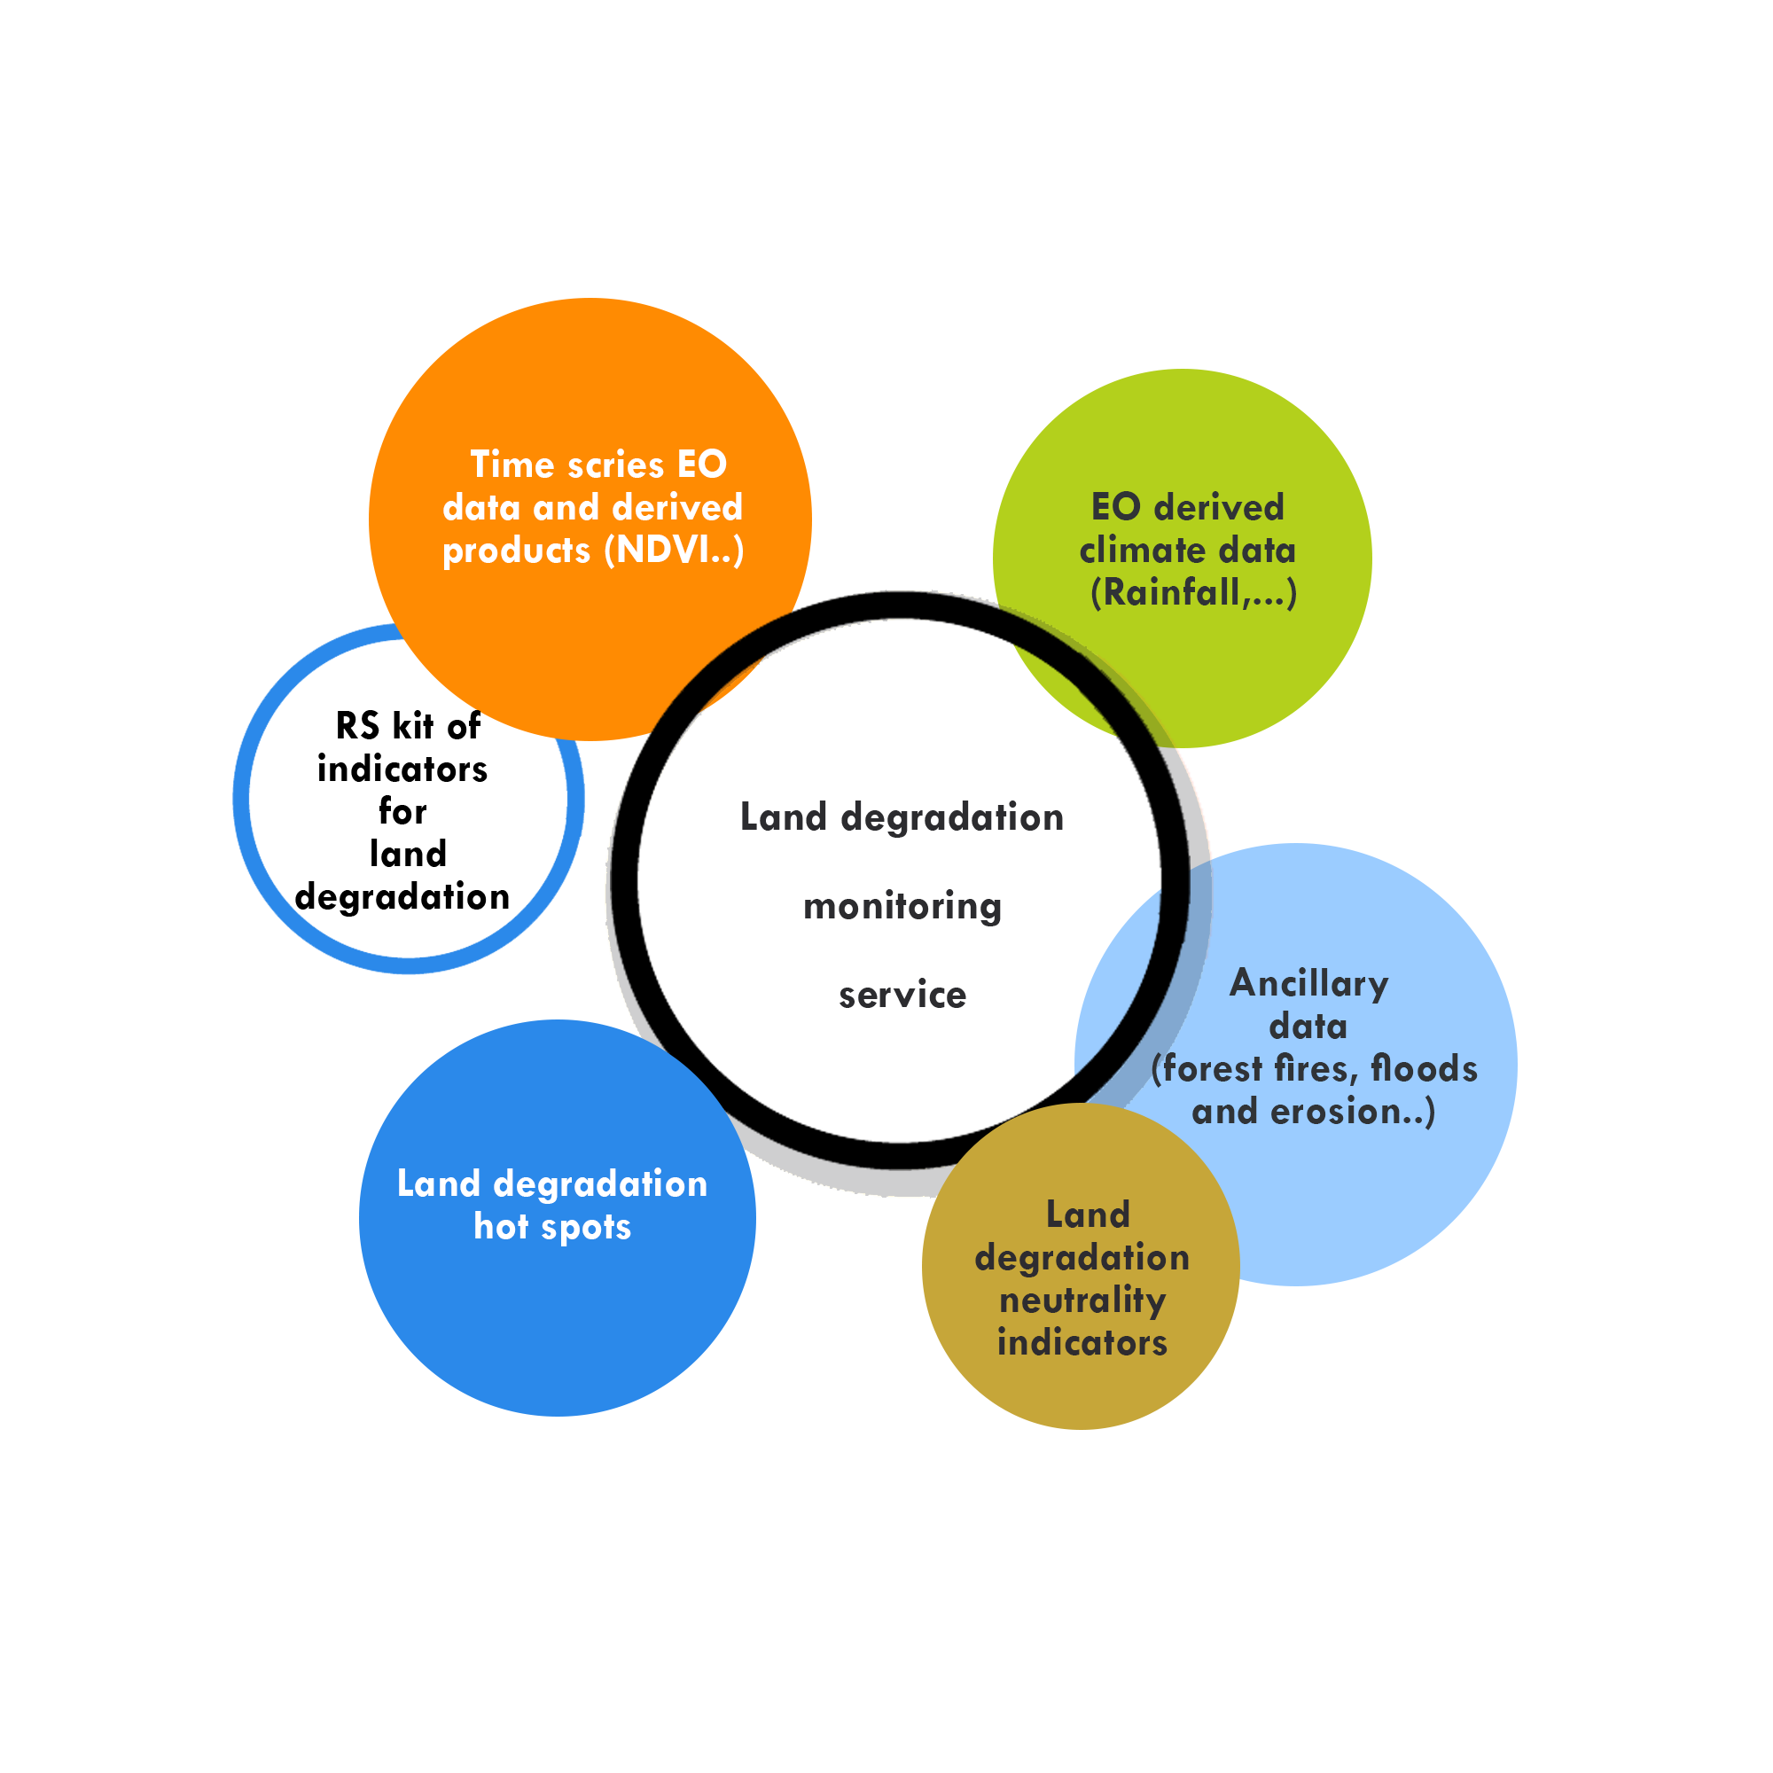
Land degradation monitoring service
Land degradation
09
Indicators
20
Years covered

Slide 6
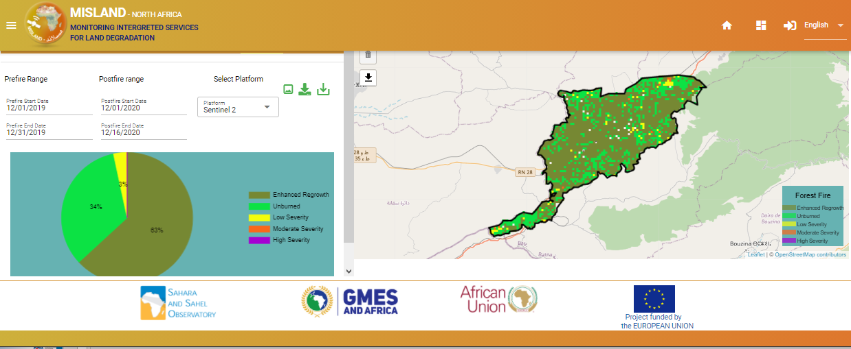
MISLAND : Development
End-users needs assessment
North-Africa specificities
International guidelines
National experiences
www.misland.oss-online.org
Integration of high spatial resolution datasets
Capacity building and knowledge management

Slide 7
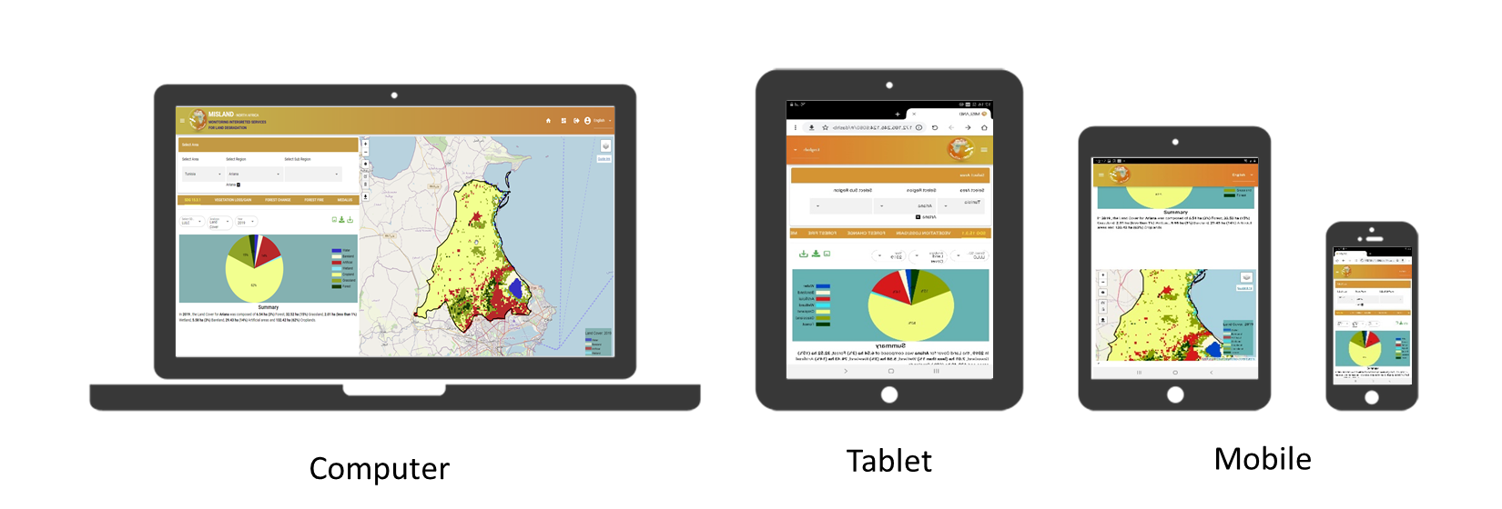
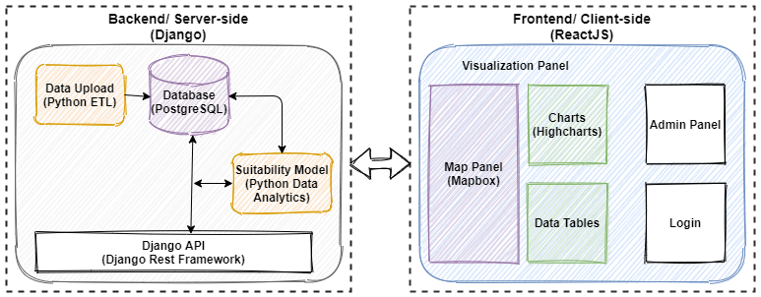
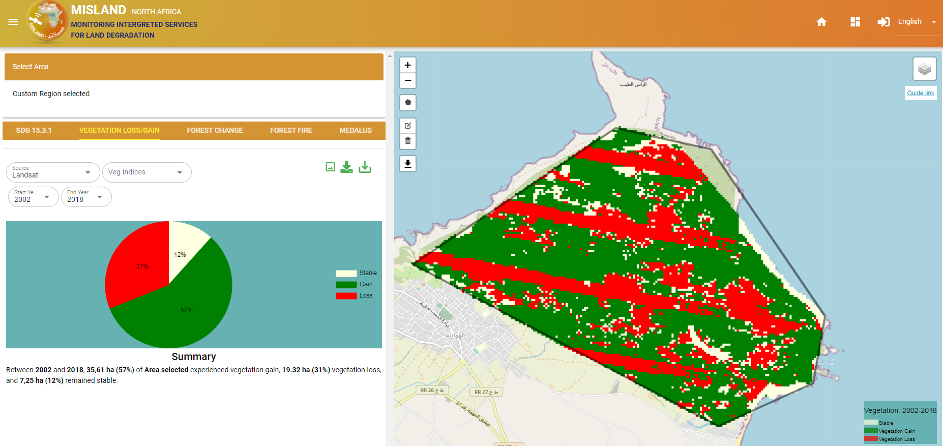
MISLAND V1 Architecture
Responsive design
Python
PostgreSQL
Django
Rest API
GEE API
HTML/CSS
VueJS
Highcharts
Leaflet
Fully open source architecture + QGIS plugin
Intuitive, interactive and easy to use

Slide 8
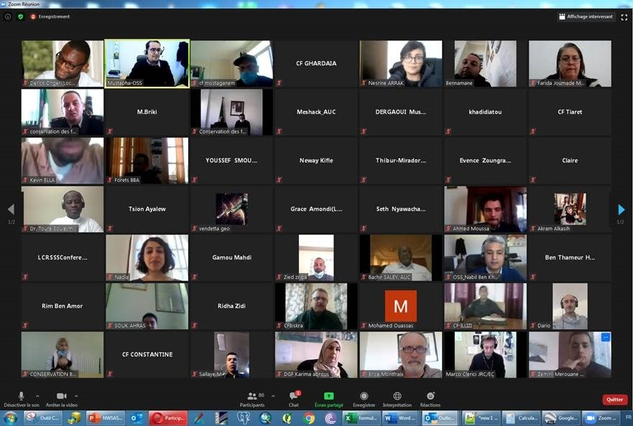
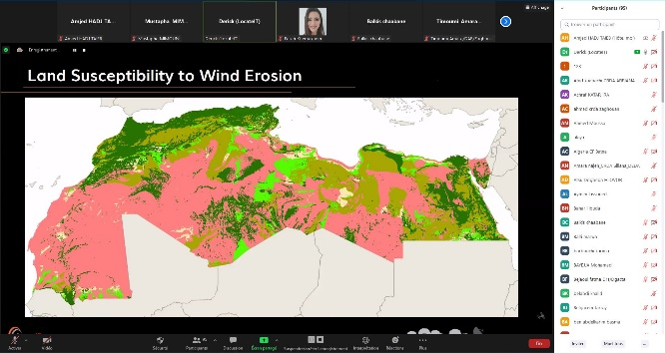
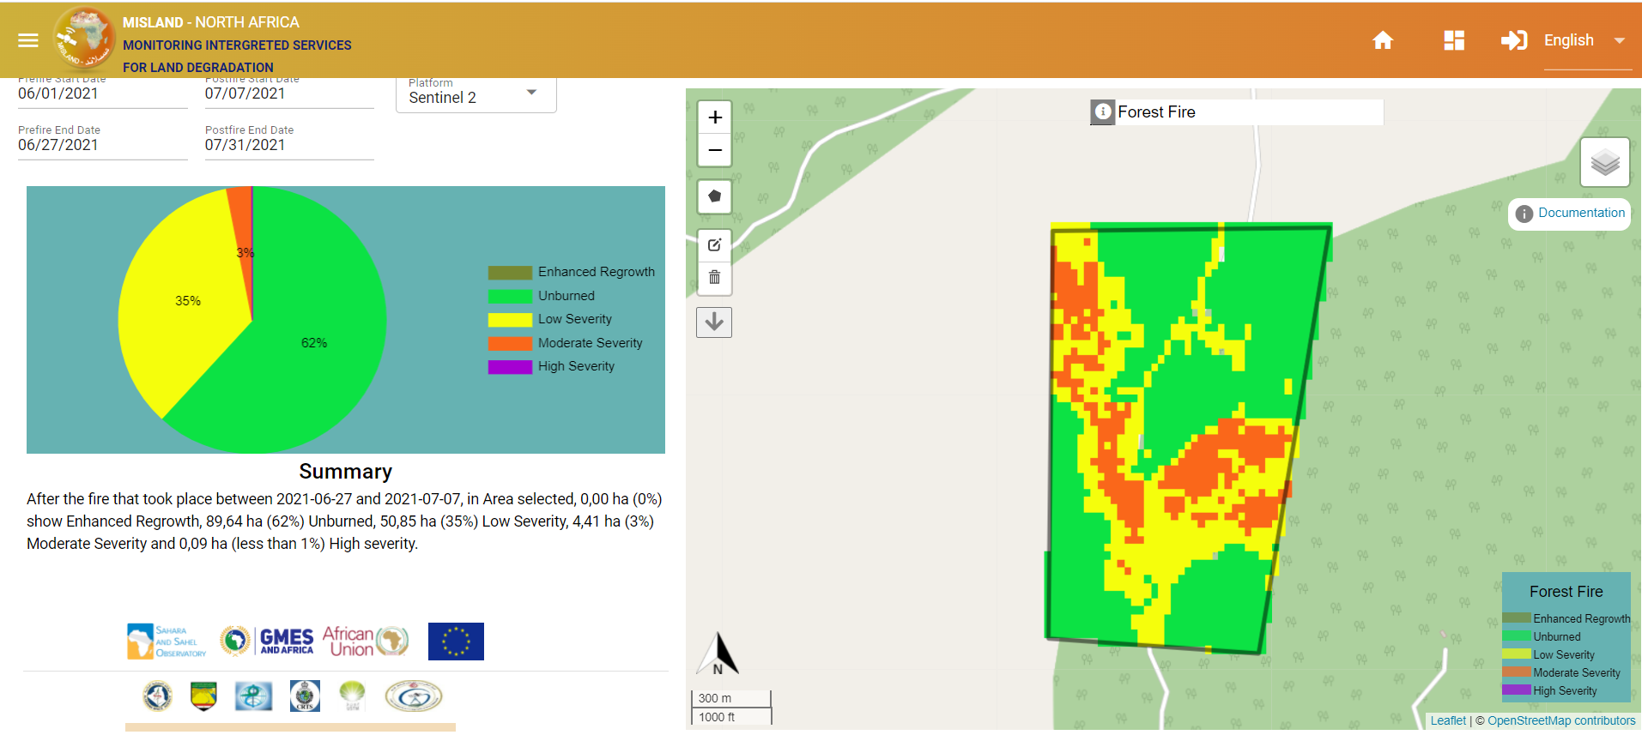
MISLAND Appropriation
Service development
Training
Appropriation
Support decision markers to monitor land degradation, develop value chains and build climate resilience in their local communities
Training on the service use through:
Training of trainers
End-user training
Training on the administration of the service
Involvement of end-users in the use of the service in their area of interest and collection of their feedback.

Slide 9
MISLAND II
MISLAND
Visualization
Mapographics
Mobile apps
GEOSERVICES
QGIS plugin
Different dashboards for different audiences
Different models / approaches to reflect the land degradation with respect to different landscapes
African experts developing their kit of land degradation monitoring indicator for AFRICA

Slide 10
Approach
Complexity of the phenomenon
Different landscapes with different specificities
Different indicators, approaches/models
Raising awareness
Common understanding of the system
Best practices sharing
Action
Collaborative framework
Academia / private sectors
What’s next
Action plan & operational roadmap
Capacity development
Operational system
Network of experts
Adapt and Adopt

Slide 11
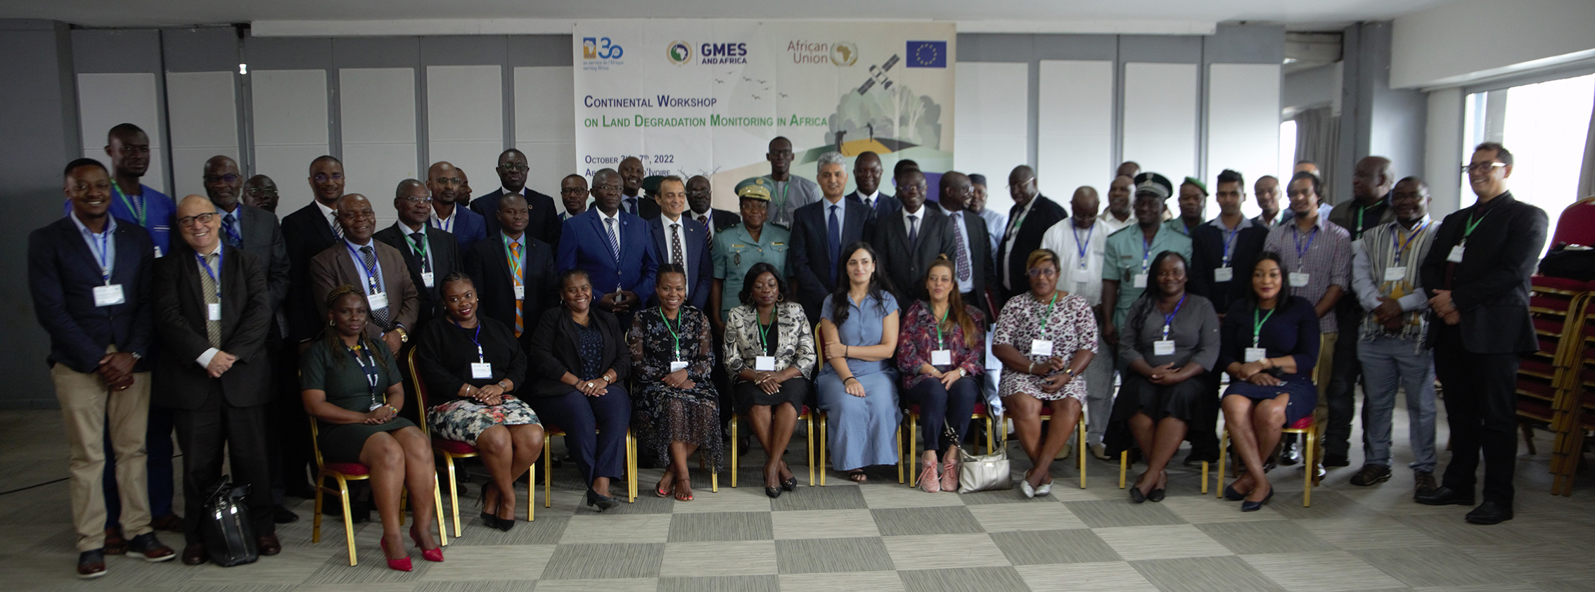
Continental land degradation workshop
Abidjan October 3rd – 7th , 2022
Share African and international experiences for capitalization
A common understanding of African-wide land degradation monitoring service
* Awareness Committee and Committee of Champion-Leader and “JOINT IMPLEMENTATION TEAM”
* Operational roadmap
AfriGEO experience was shared, along with :
UNCCD, FAO, AGRHYMET/CILSS, RCMRD, CSIR, SASSCAL, ICPAC, CSE, ABN, JRC, CICOS, OSS

Slide 12
Strategies for the service developing
Work in synergy with consortia
Ensure the scaling up of the land degradation monitoring services
Connect MISLAND-Africa to local Data-centers (cloud computing technology)
Propose to the various institutions to share their achievements in the monitoring of LD
Align the needs with the priorities of each institution involved
Develop a joint communication strategy and its action plan
Work with regional and national institutions to validate the products
Develop the first version of the ToRs and framework of Joint Implementation Network
Products validation & harmonisation

Slide 13
For better monitoring of the land degradation service
EO advocacy + Multi-level mapping
Awareness raising
More confidence of champion users in data sharing
More reliable products highlighting the field reality
More implication and engagement of others sectors
Involvement of multi-thematic experts (national and regional levels)
Land degradation service improved assessment
Better apprehension of countries’ improved and degraded areas

Slide 14
Thanks for your attention
« We all agree that land degradation is severely hitting the African continent and increasingly compromising food security of our populations. Together, let us make « GMES&Africa » and space technologies a groundbreaking tool in the fight against land degradation and a driver of socio-economic development in Africa. We need to maintain hope and join our efforts to preserve our land and make a brighter future for our continent. » Abidjan, October 7, 2022.
For any additional information :
Contact person: Mustapha MIMOUNI (mustapha.mimouni@oss.org.tn )

